Slide 1
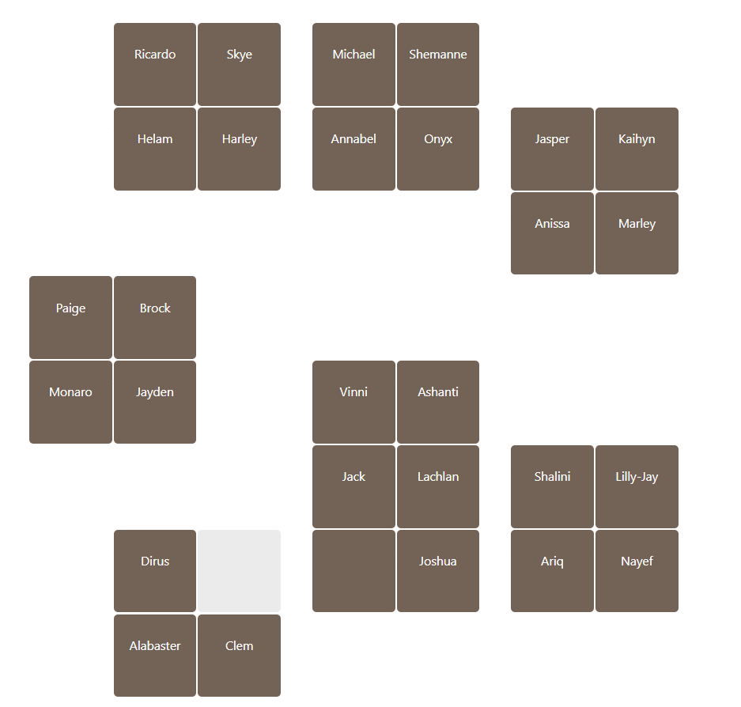

Slide 2
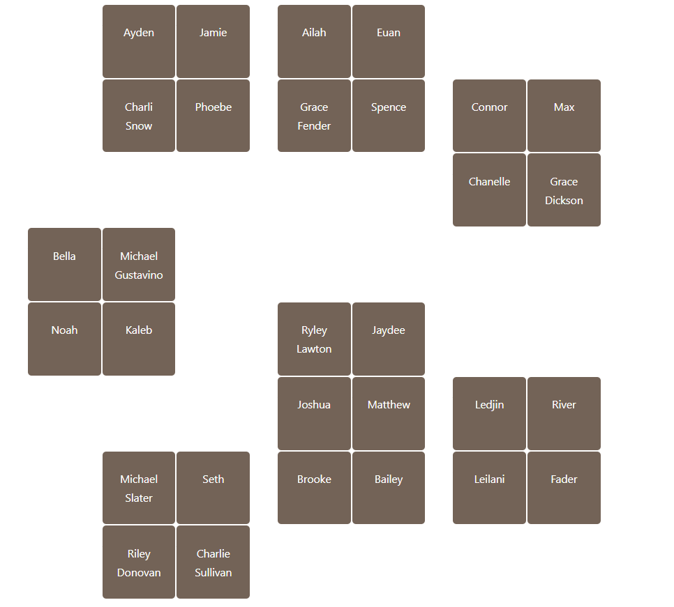

Slide 3
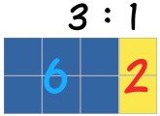
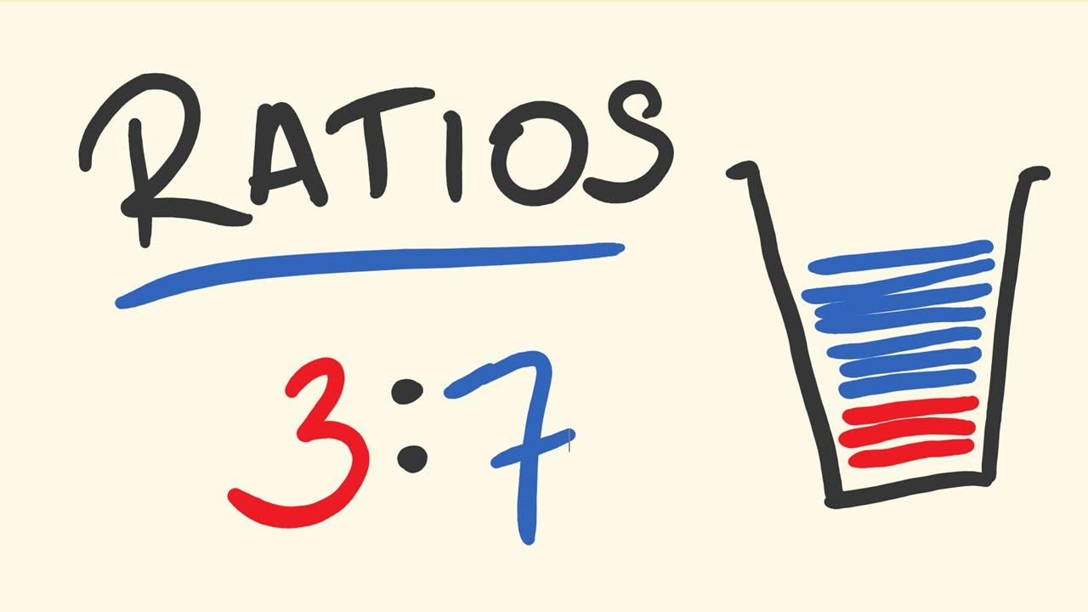
Rates and Ratio
Name:
Class:
Teacher:
Term 2 Semester 1

Slide 4

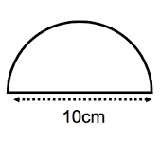
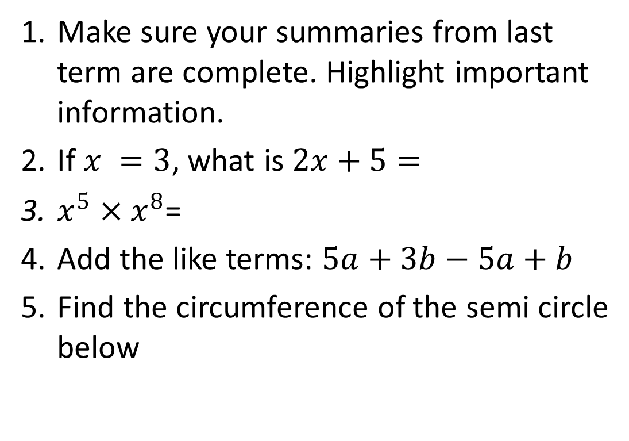
Have a go at these questions:
Topic: Ratios EQ: What is a ratio and how is it used?
Make sure your summaries from last term are complete. Highlight important information.
If $x =3$, what is $2x+5=$
$x^{5}×x^{8}$=
Add the like terms: $5a+3b−5a+b$
Find the circumference of the semi circle below

Slide 5
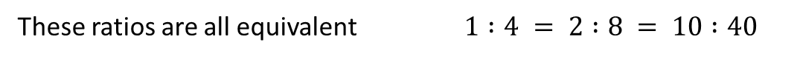
24
7
30
Date
Topic: Ratios
EQ – What is a ratio and how is it used?
What is a ratio?
Ratios are used to compare quantities with the same units.
The ratio of 2 to 5 is written as 2 : 5
How is a ratio used?
If you are making cordial and you mix one part cordial to four parts water, then the ratio of cordial to water will be 1:4 (1 to 4).
If you use 1L of cordial, you will use 4L of water (1:4).
If you use 2L of cordial, you will use 8L of water (2:8).
If you use 10L of cordial, you will use 40L of water (10:40).
What are equivalent ratios?
These ratios are all equivalent $1 :4 = 2 :8 = 10 :40$

Slide 6
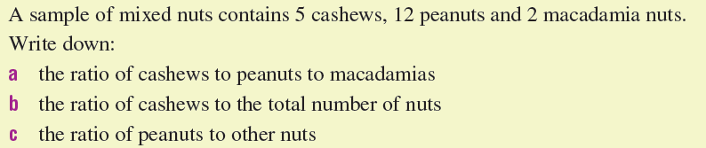
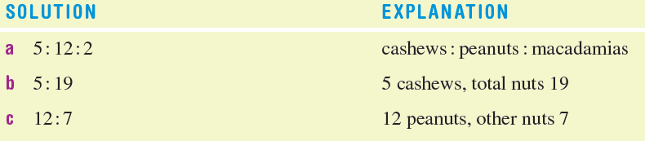
For example…

Slide 7

Do you understand? Fists of Five
Notes:
Check for Understanding

Slide 8
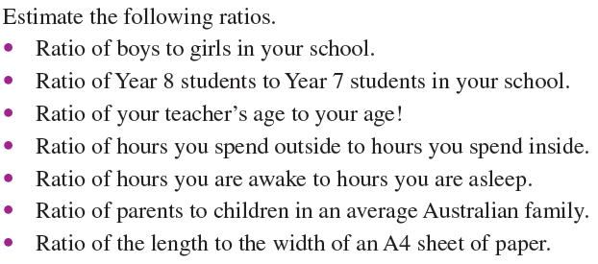

Let’s have a try together

Slide 9
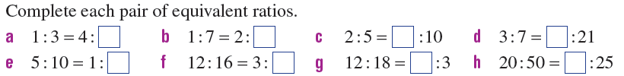
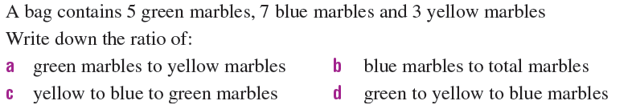
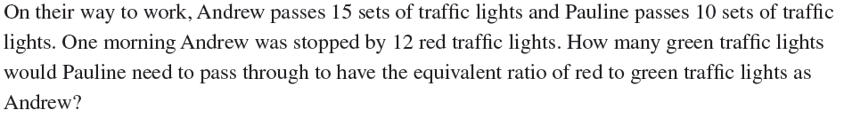
Now you have a go
1.
2.
3.
4.

Slide 10
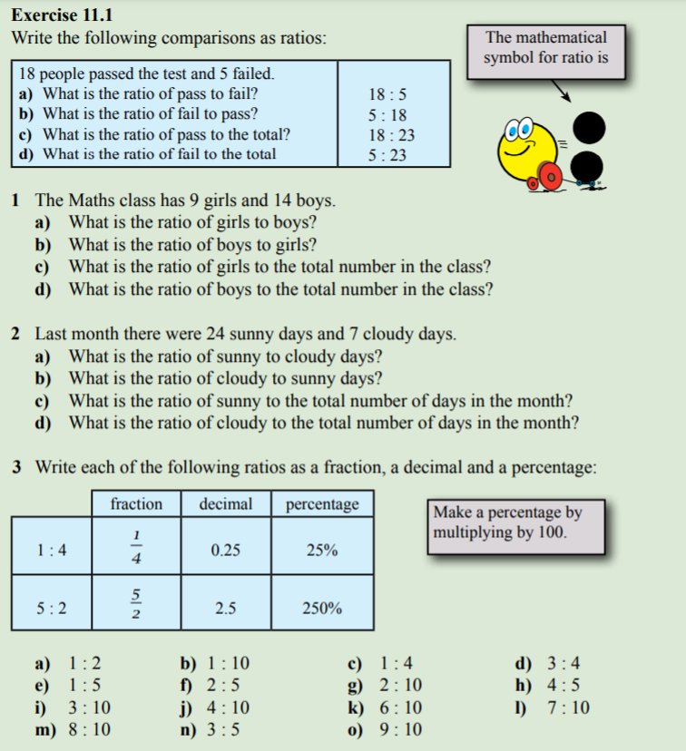

Slide 11

Have YOU been doing your summaries?

Slide 12
Notes Review
24, 7 ,30
Date
Title
Essential question
Notes complete
Notes complete with colour and diagrams
Questions completed
Contents page filed in
Formula page filled in

Slide 13
Homework
Review your notes and write a summary answering the essential question.

